Slide 3
About Me
.NET Developer with 14 years’ experience
Focused on authentication, APIs, and enterprise integration
Organize the Michigan .NET Users Group in Southfield, MI
Organize the Michigan Technology Conference (MITechCon)

Slide 4
Why I Care About Authentication
Authentication touches every user, every app
It’s the first thing people see and the hardest to get right
Often last thing thought of in a project

Slide 7
Pain Points
Legacy custom user tables
Duplicated authentication logic
ADFS downtime

Slide 8
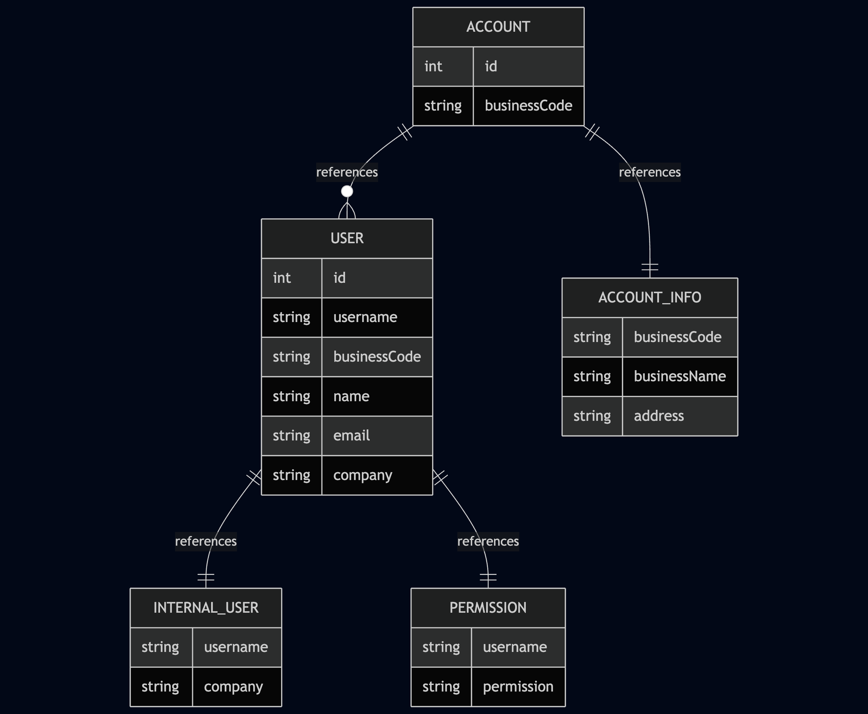
Database

Slide 9
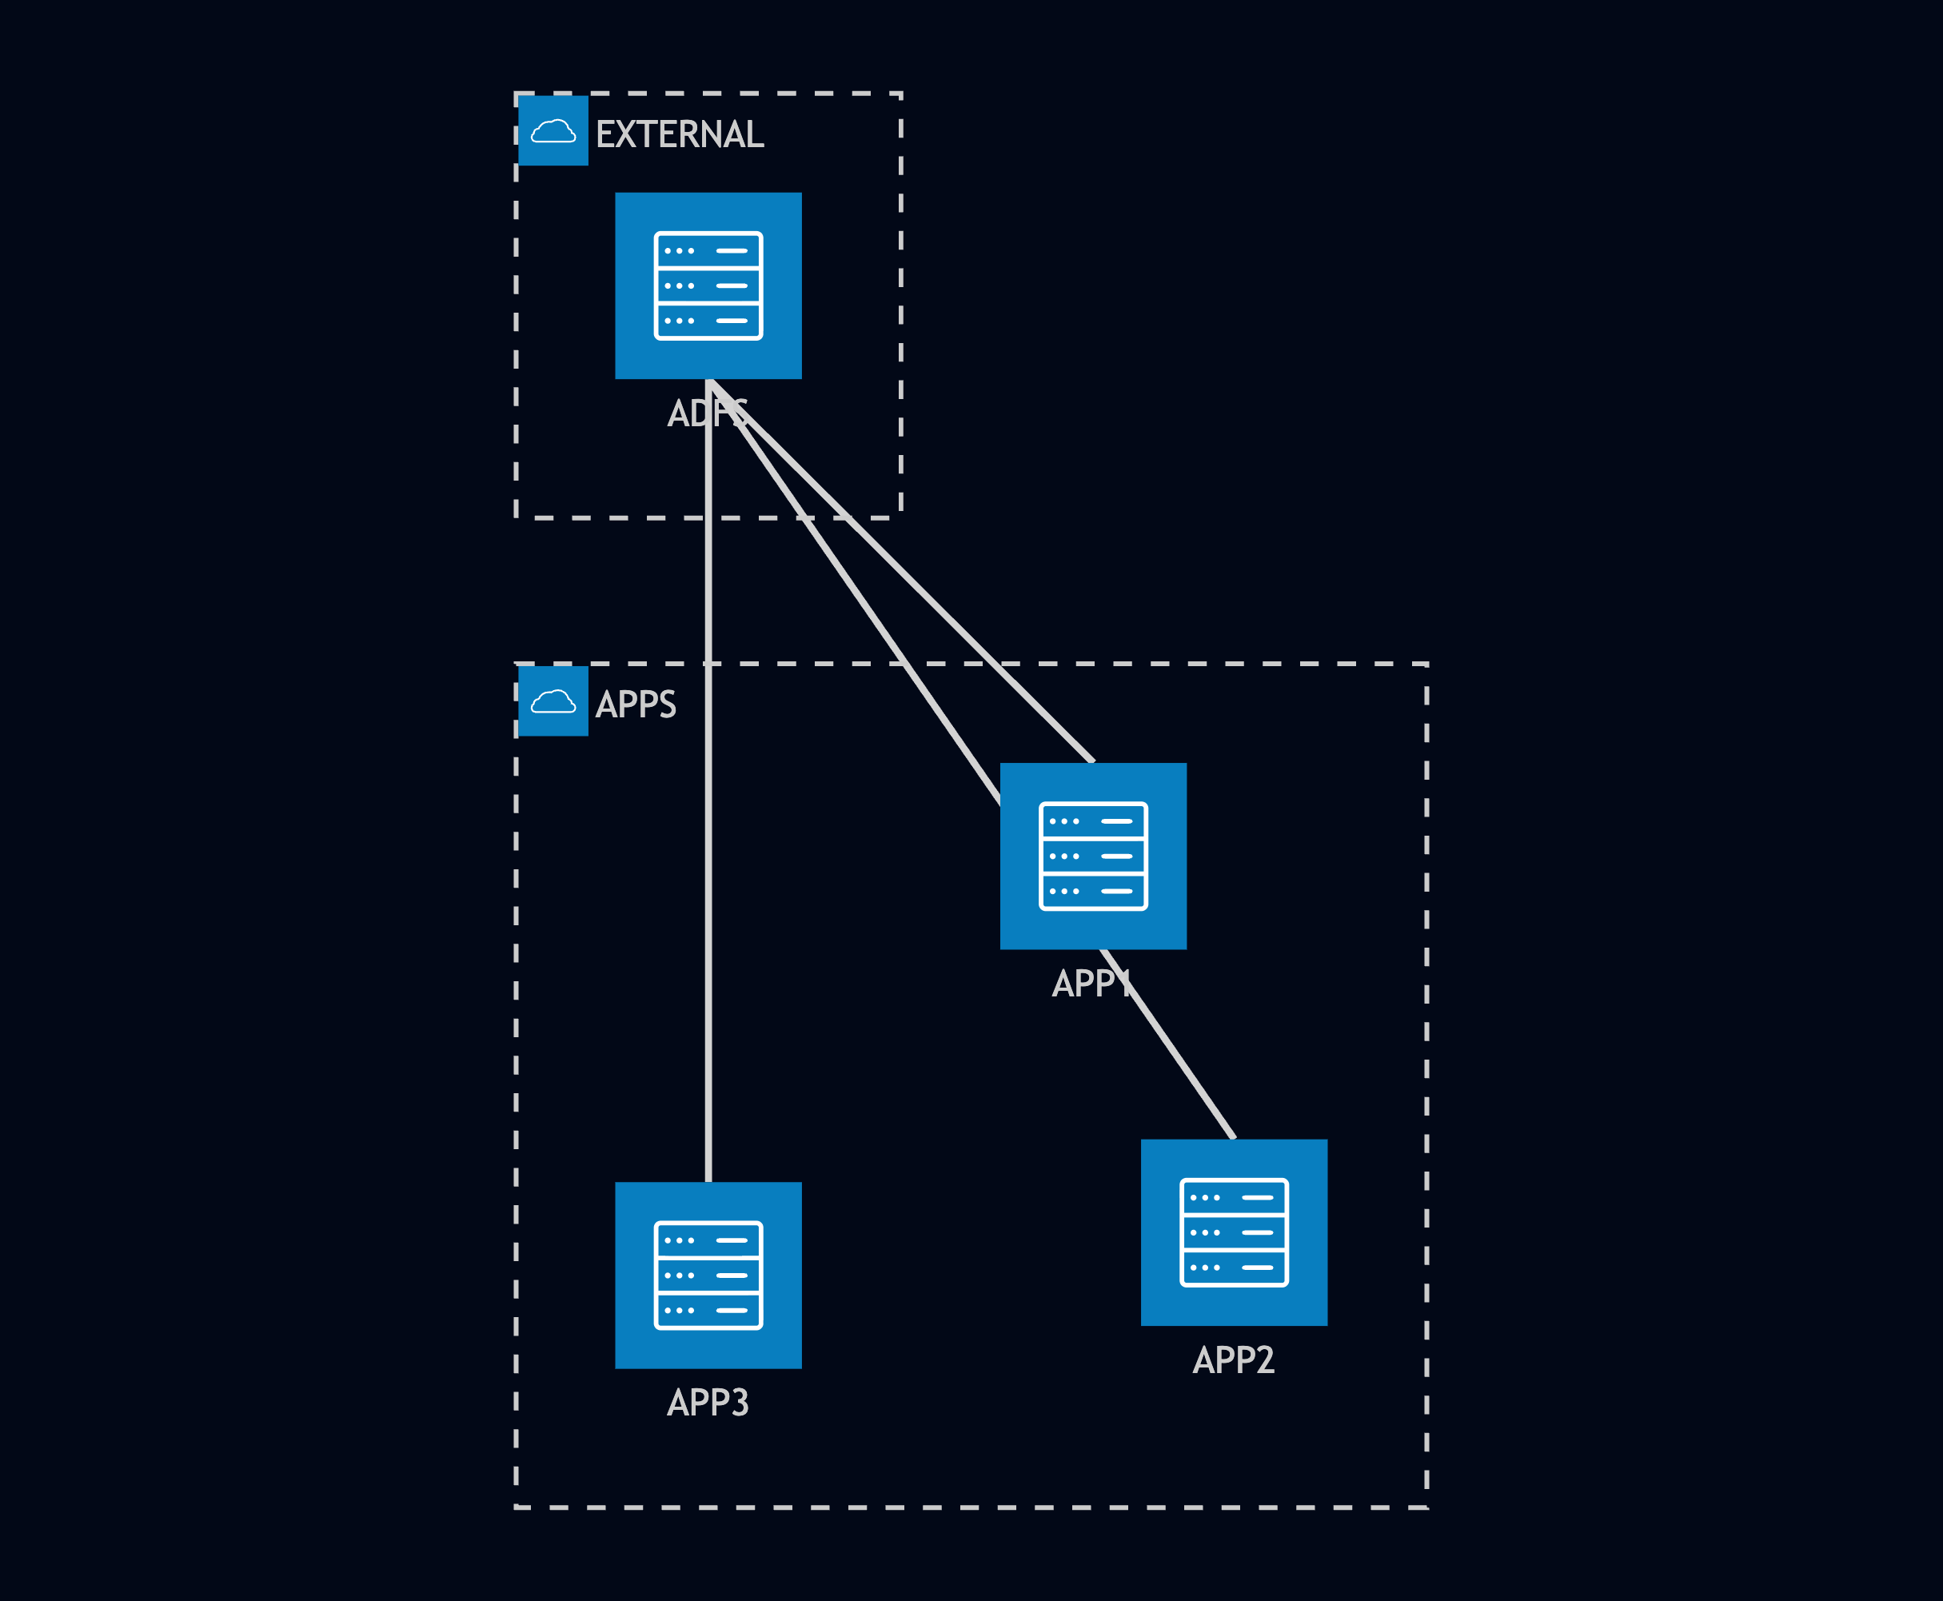
Architecture Before

Slide 10
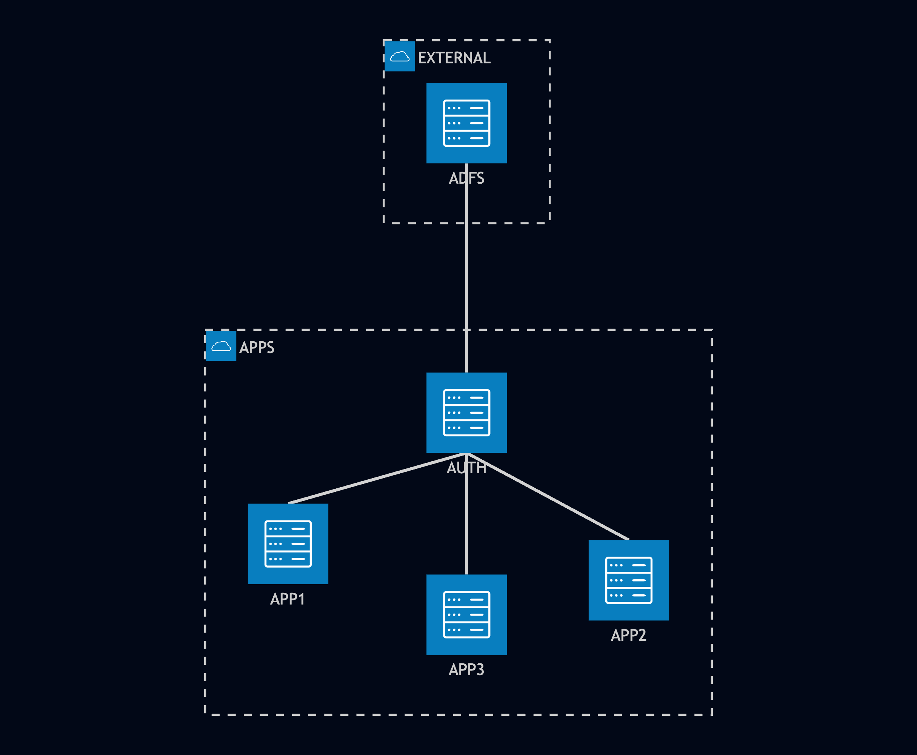
Architecture After

Slide 11
Summary
Consistent id_token between apps
Increased reliability from external OIDC

Slide 13
OpenIddict Intro
Created in 2015
Supports common OAuth 2.0/OpenId Connect flows
Minimal coding
Persistent sessions
Self managing

Slide 14
OpenIddict Modes
Client – Connect to providers
Supports 100+ popular services
Server – Create providers
Validation – Protect APIs

Slide 15
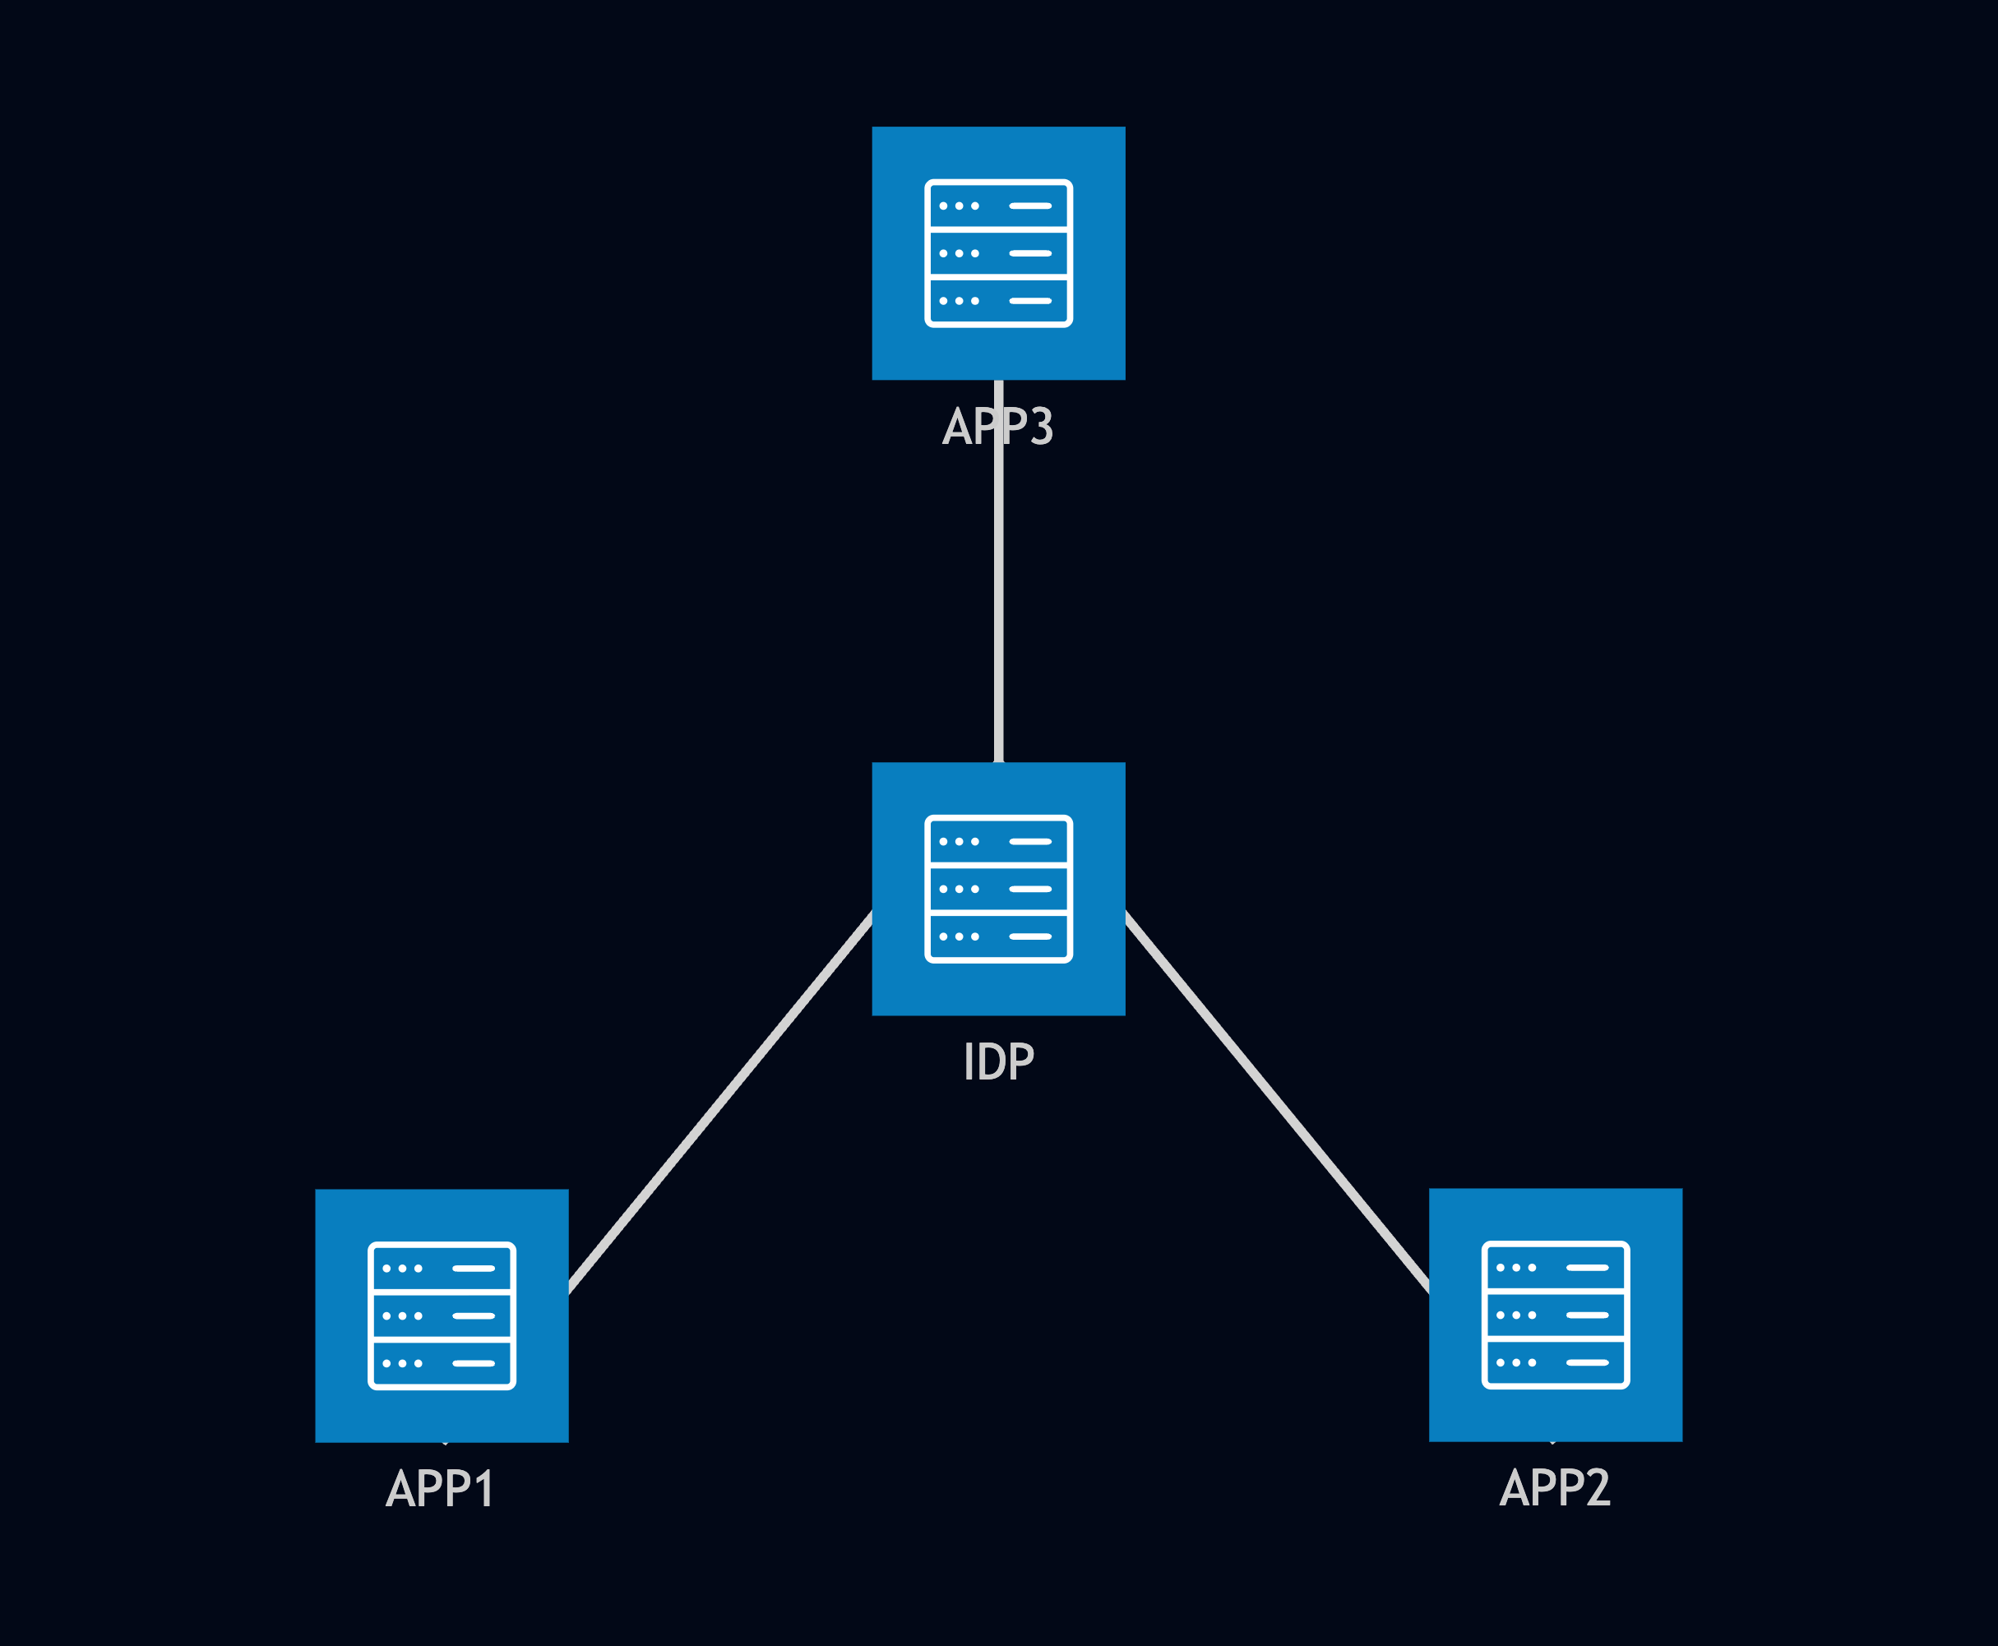
OpenIddict Client

Slide 16
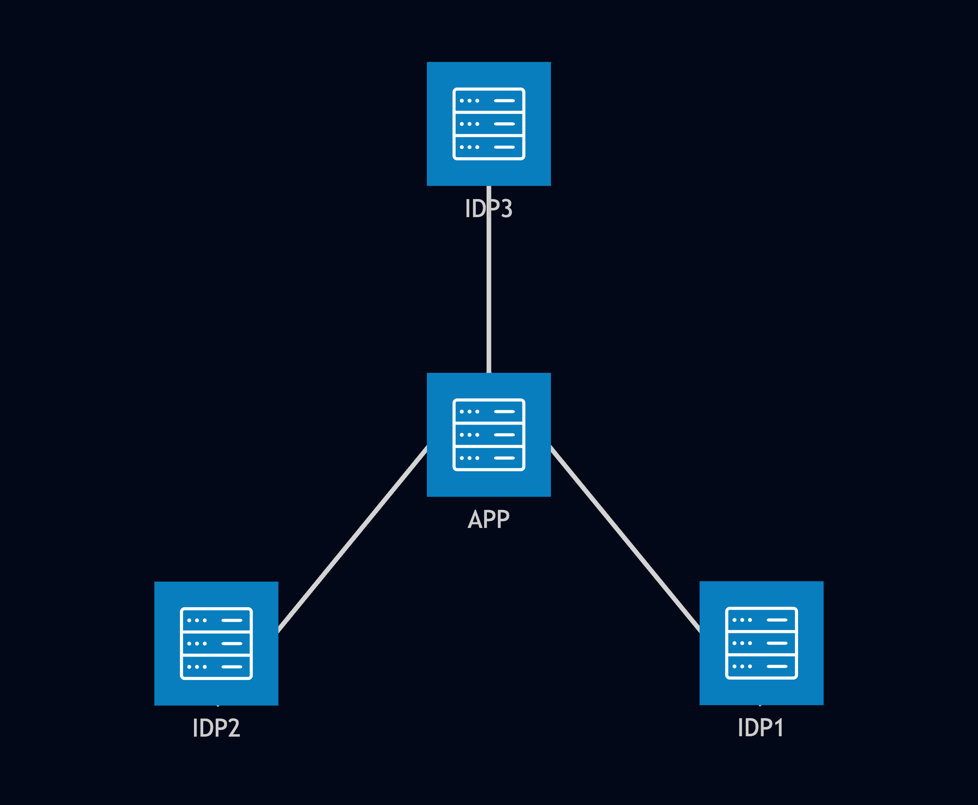
OpenIddict Server

Slide 17
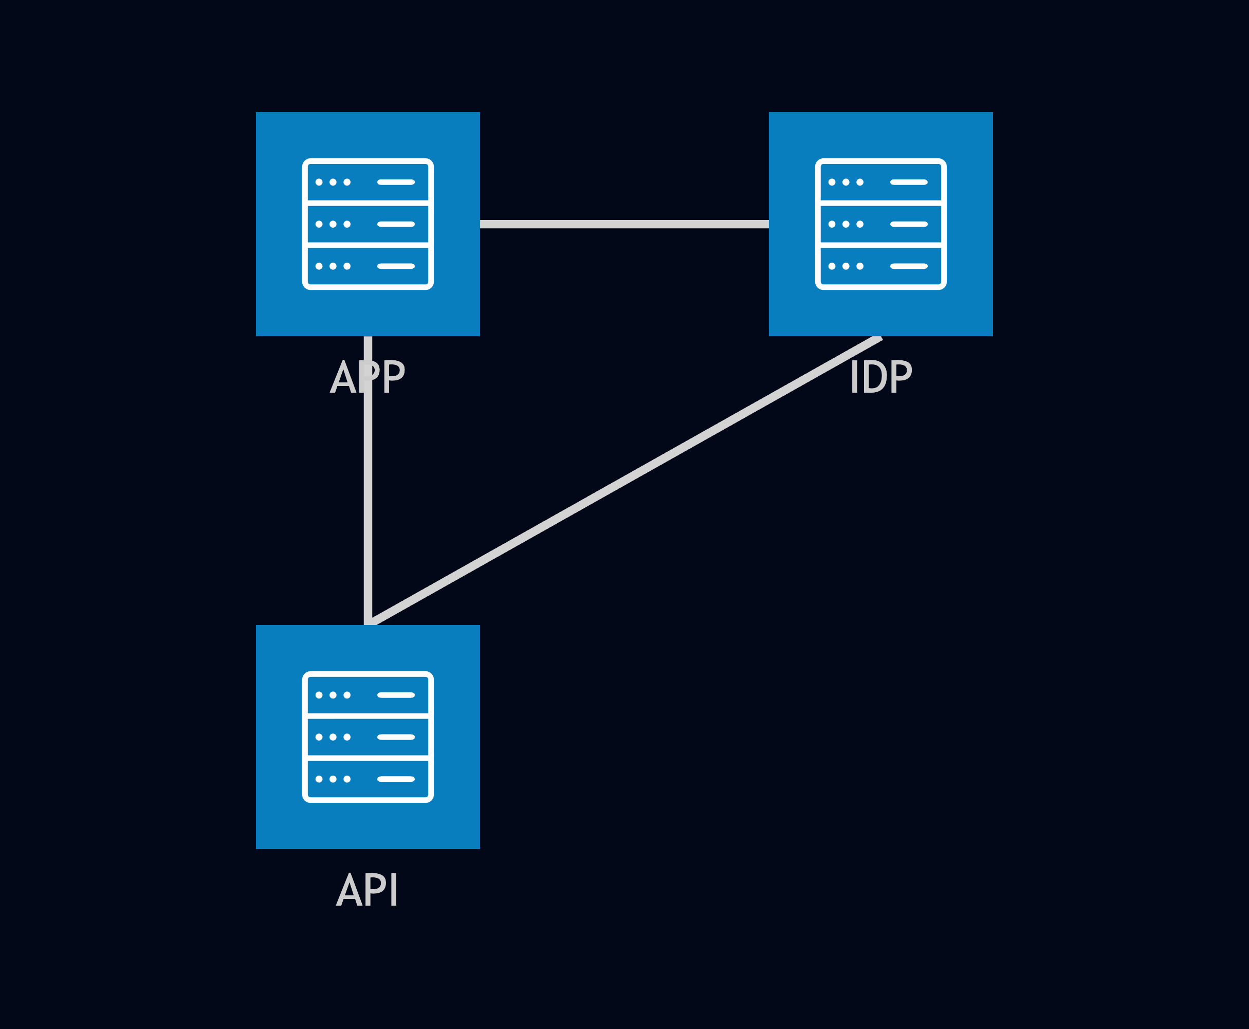
OpenIddict Validation

Slide 18
OpenIddict Operating Systems
Android 5.0+ (Android API 21+)
iOS 12.2+
Linux
macOS 12.0+
Mac Catalyst 15.0+
Windows 7 SP1

Slide 19
OpenIddict Integrations
Storage
EF / EF Core
MongoDB
DynamoDB
CouchDB
ASP.NET Core Data Protection (DPAPI)
Quartz.NET (automate cleanup tasks)

Slide 20
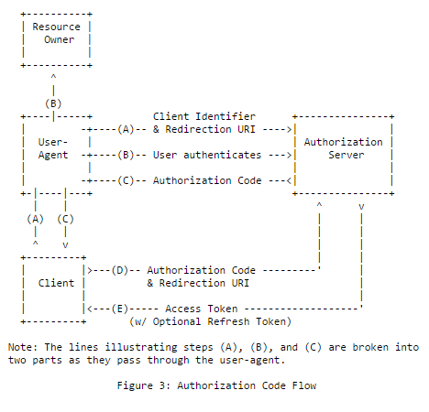
Authorization Code Flow

Slide 21
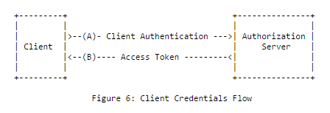
Client Credentials Flow

Slide 23
Getting Started
Based on Velusia sample
Local or GitHub logins
ASP.NET Core Identity backend
Minimal OIDC Setup

Slide 25
Custom Data Storage
Based on Mimban sample
Passthrough to GitHub
Minimal implementation

Slide 27
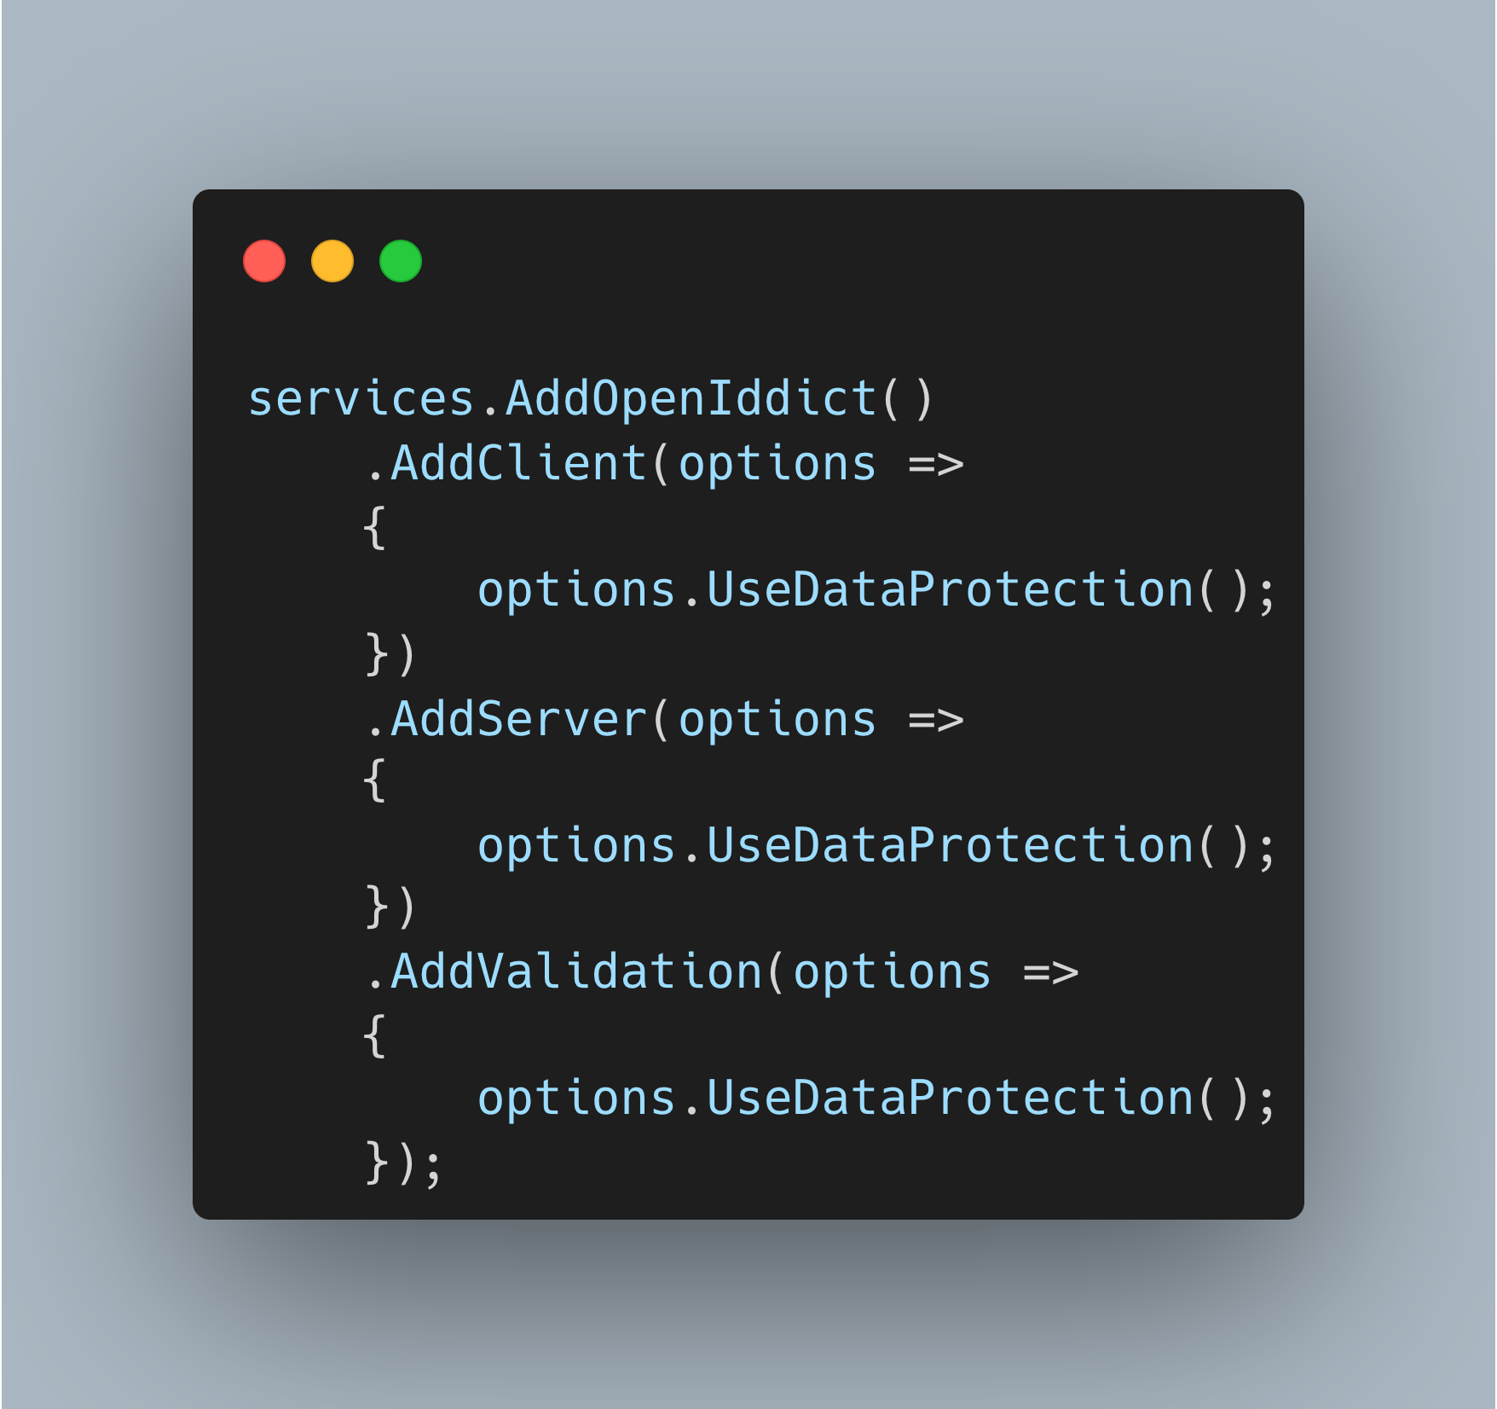
ASP.NET Core Data Protection

Slide 28
Certificates
Azure Key Vault
Azure App Service – WEBSITE_LOAD_CERTIFICATES flag
Local Machine Store

Slide 29
id_token
Keep it small
Use userinfo endpoint for most claims

Slide 30
Resources
OpenIddict Docs - documentation.openiddict.com
OpenIddict Samples - github.com/openiddict/openiddict-samples
Kévin Chalet (Creator / Maintainer) - kevinchalet.com

Slide 31
Contact
Email: me@dustinkingen.com
GitHub: DustinKingen

